Slide 1
SUPPLEMENTARY FIGURES
tRNA – RF00005
Pre-APC correction
Post-APC correction
Supplementary Figure 1: Example of noise reduction afforded by an APC correction on the SoM results for an MLP trained on the alignment for tRNA (RF0005). SoM scores are averaged across SoM on 500 sequences from the test set. Before the correction, there is a lot of background noise from reductions caused additive mutations in the rows and columns. An APC correction removes this noise making the scores associated with base pairs in the tRNA structure visible.

Slide 2
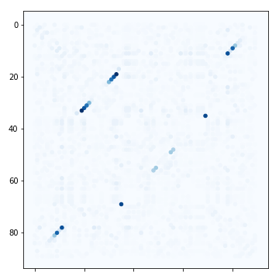
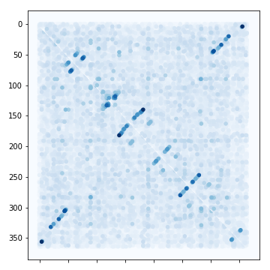
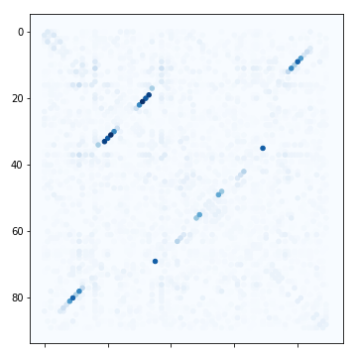
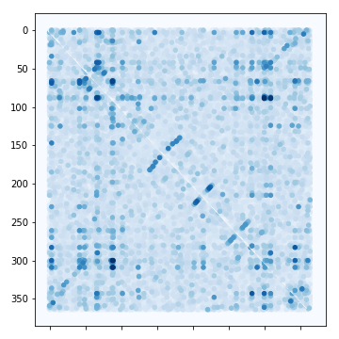
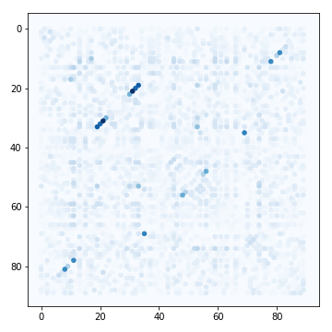
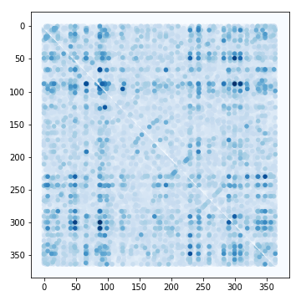
A
Glycine Riboswitch
B
Transfer—messenger RNA
Training set size:
1000
800
300
Supplementary Figure 2: Example SoM results from MLPs trained (A) Glycine Riboswitch – RF00504 (an alignment of 91 nucleotides in length) and (B) transfer-messenger RNA – RF00023 (an alignment of 366 length) at training set sizes of 1000, 800 and 300 sequences. The SoM results get less clear as the training size decreases for both families, suggesting that depth of training set is an important factor that influences an MLPs ability to learn structure. The results for MLPs trained on Glycine Riboswitch seems to be more robust to lower training sizes, suggesting that even with shallow training sets, an MLP can still learn structure if the alignment is short.

Slide 3
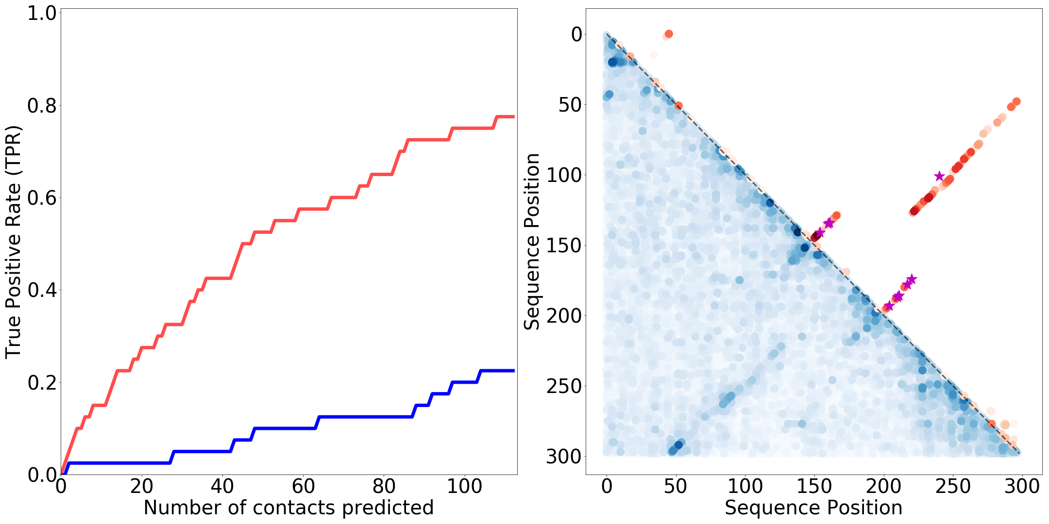
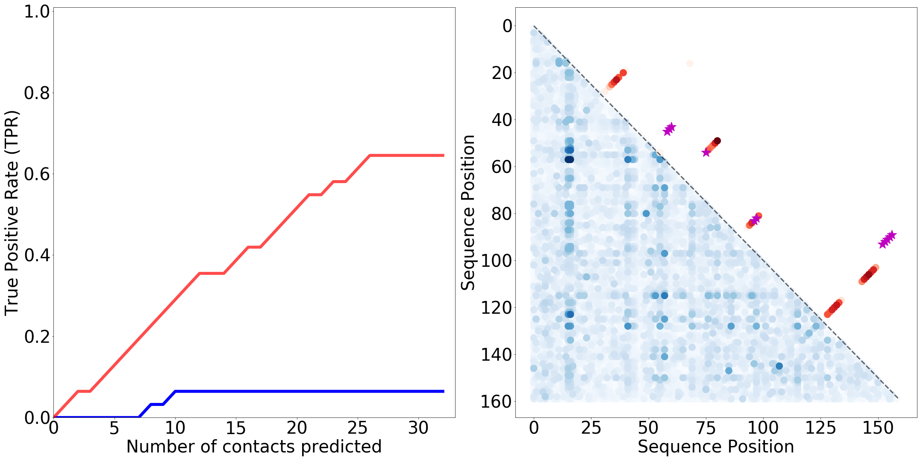
A - Metazoan signal recognition particle RNA (RF00017)
Length = 300 M = 22685 M_{eff} = 4358.5
SoM TPR
R-scape TPR
High SoM score
High R-scape score
B - glmS glucosamine-6-phosphate activated ribozyme (RF00234)
Length = 161 M = 842 M_{eff} = 203.6
Low SoM score
Low R-scape score
SoM
R-scape scores
WC not found by R-scape
Supplementary Figure 3: continued on next page.
Notes:
Only pngs

Slide 4
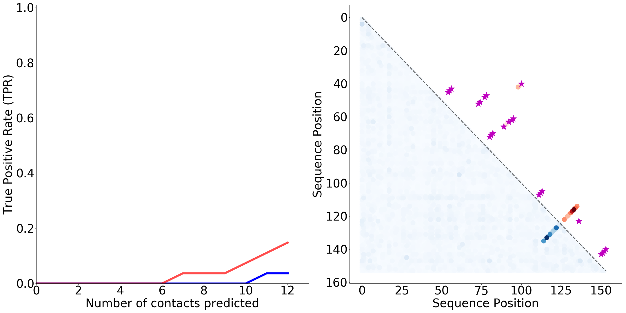
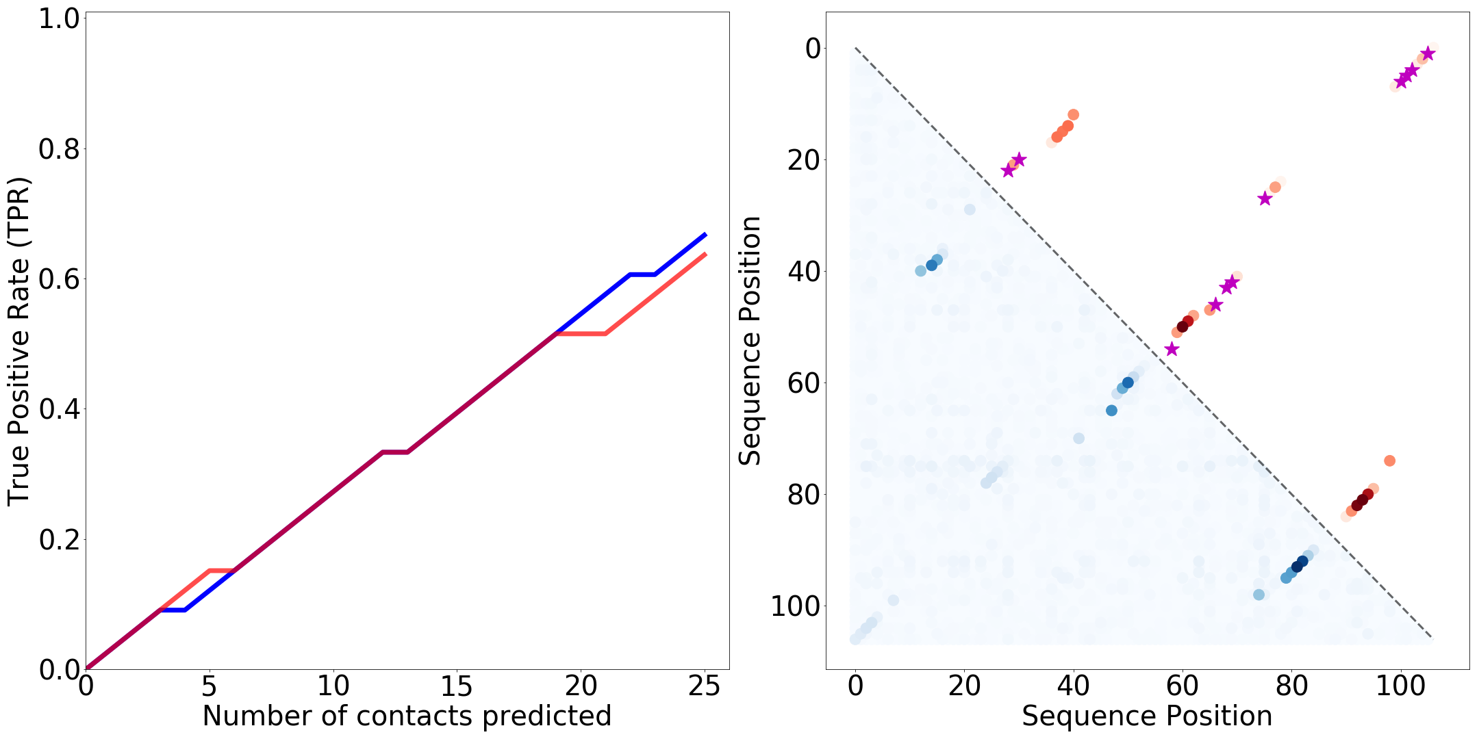
C - 5.8S ribosomal RNA (RF00002)
Length = 155 M = 375612 M_{eff} = 1197.3
SoM TPR
R-scape TPR
High SoM score
High R-scape score
D - SAM riboswitch (S box leader) (RF00162)
Length = 108 M = 4757 M_{eff} = 585.7
Low SoM score
Low R-scape score
SoM
R-scape scores
WC not found by R-scape
Supplementary Figure 3: ranked TPR graphs and plots of SoM scores and R-scape scores for interesting outliers of the summary TPR comparison (Figure 8). Metazoan SRP and glmS activate ribozyme (A,B) are the two families for which R-scape outperforms the MLP most severely. 5.8S ribosomal RNA (C) is the family for which both R-scape and the MLP had their lowest performance. SAM Riboswitch (D) is another example of a family for which the MLP had very similar performance to R-scape.
Notes:
Only pngs

Slide 5
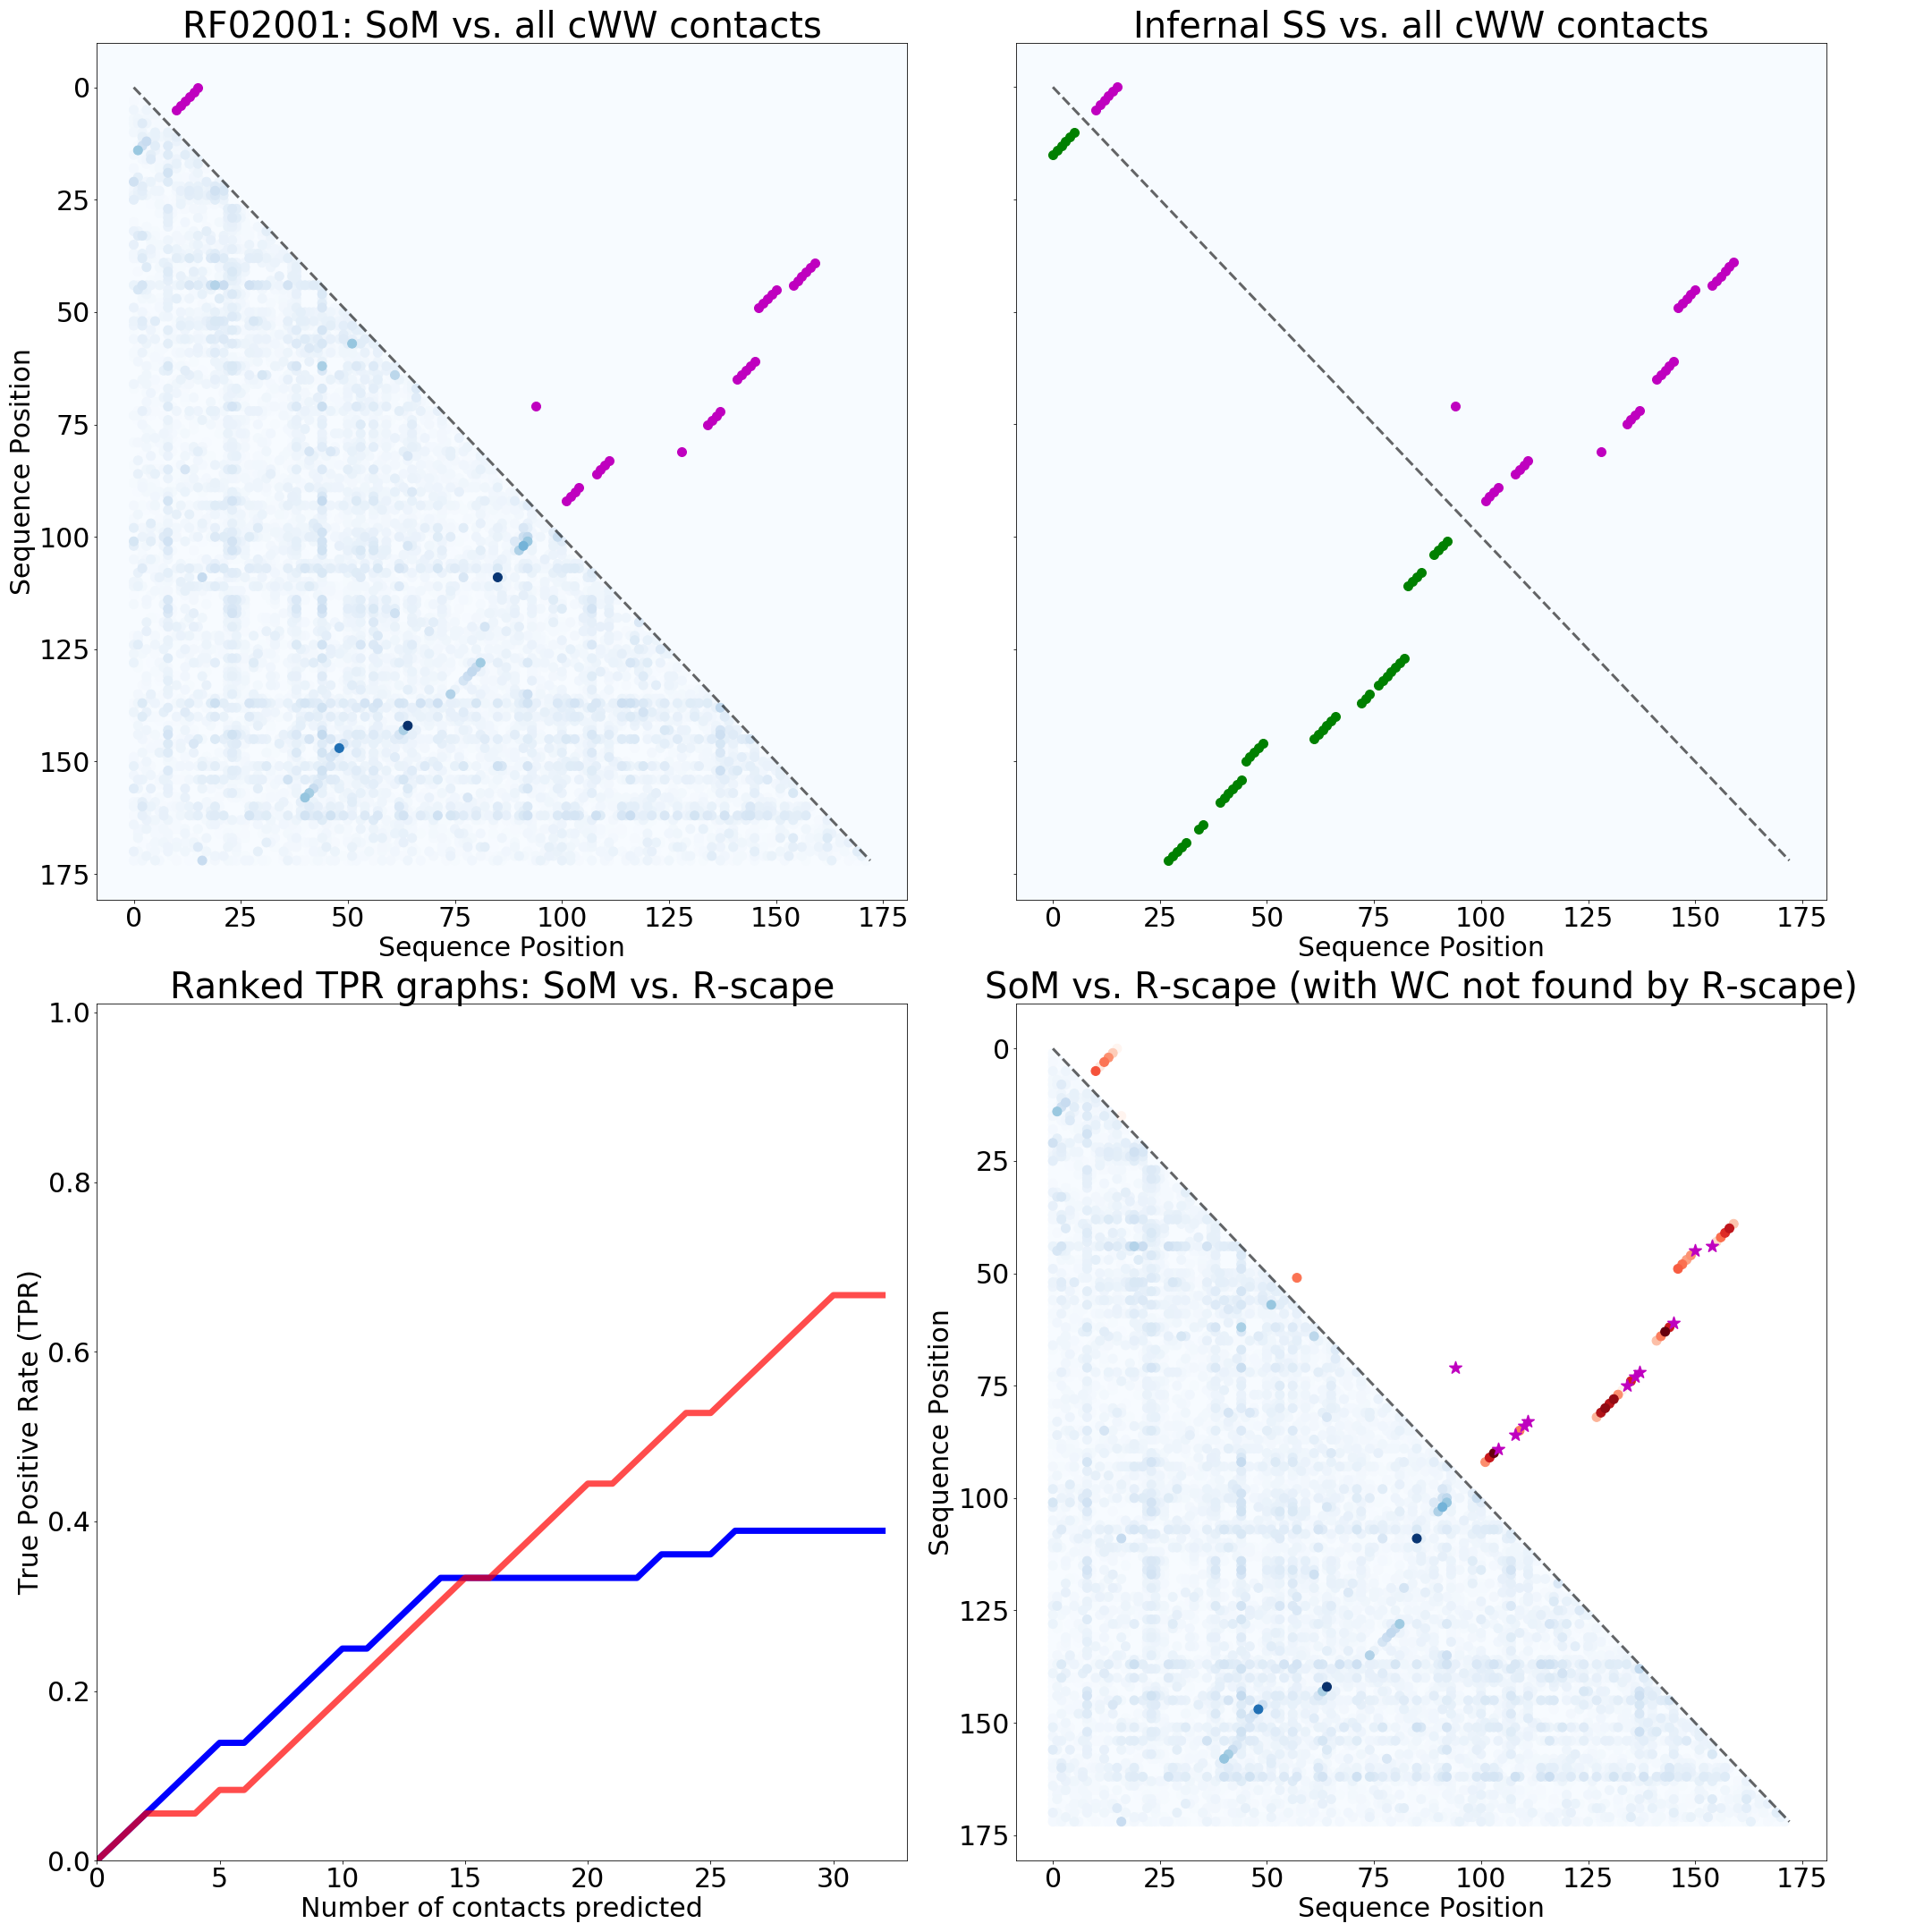
APPENDIX
Here we show the results from each MLP trained on the other Rfam families tested that are not in the main text. Below are SoM scores from a trained MLP compared to WC annotations, Infernal’s SS prediction, R-scape’s base pair prediction and the ranked TPR graph comparing an MLP’s performance to R-scape’s. See main text figures for legends
RF00017 - Metazoan signal recognition particle RNA

Slide 6
RF00017 - Metazoan signal recognition particle RNA

